Slide 1

Elementary Statistics
Thirteenth Edition
Chapter 4
Probability
Copyright © 2018, 2014, 2012 Pearson Education, Inc. All Rights Reserved

Slide 2
Probability
4-1 Basic Concepts of Probability
4-2 Addition Rule and Multiplication Rule
4-3 Complements and Conditional Probability, and Bayes’ Theorem
4-4 Counting
4-5 Probabilities Through Simulations (available at TriloaStats.com)

Slide 3
Key Concept
The single most important objective of this section is to learn how to interpret probability values, which are expressed as values between 0 and 1. A small probability, such as 0.001, corresponds to an event that rarely occurs.

Slide 4
Basics of Probability
An event is any collection of results or outcomes of a procedure.
A simple event is an outcome or an event that cannot be further broken down into simpler components.
The sample space for a procedure consists of all possible simple events. That is, the sample space consists of all outcomes that cannot be broken down any further.

Slide 5
Example: Simple Events and Sample Spaces (1 of 5)
In the following display, we use “b” to denote a baby boy and “g” to denote a baby girl.
Procedure | Example of Event | Sample Space: Complete List of Simple Events
Single birth | 1 girl (simple event) | {b, g}
3 births | 2 boys and 1 girl (bbg, bgb, and gbb are all simple events resulting in 2 boys and 1 girl) | {bbb, bbg, bgb, bgg, gbb, gbg, ggb, ggg}

Slide 6
Example: Simple Events and Sample Spaces (2 of 5)
Solution
Simple Events:
With one birth, the result of 1 girl is a simple event and the result of 1 boy is another simple event. They are individual simple events because they cannot be broken down any further.

Slide 7
Example: Simple Events and Sample Spaces (3 of 5)
Solution
Simple Events:
With three births, the result of 2 girls followed by a boy (ggb) is a simple event.
When rolling a single die, the outcome of 5 is a simple event, but the outcome of an even number is not a simple event.

Slide 8
Example: Simple Events and Sample Spaces (4 of 5)
Solution
Not a Simple Event: With three births, the event of “2 girls and 1 boy” is not a simple event because it can occur with these different simple events: ggb, gbg, bgg.

Slide 9
Example: Simple Events and Sample Spaces (5 of 5)
Solution
Sample Space: With three births, the sample space consists of the eight different simple events listed in the above table.
Procedure | Example of Event | Sample Space: Complete List of Simple Events
Single birth | 1 girl (simple event) | {b, g}
3 births | 2 boys and 1 girl (bbg, bgb, and gbb are all simple events resulting in 2 boys and 1 girl) | {bbb, bbg, bgb, bgg, gbb, gbg, ggb, ggg}

Slide 10
Three Common Approaches to Finding the Probability of an Event (1 of 6)
Notation for Probabilities
P denotes a probability.
A, B, and C denote specific events.
P(A) denotes the “probability of event A occurring.”

Slide 11
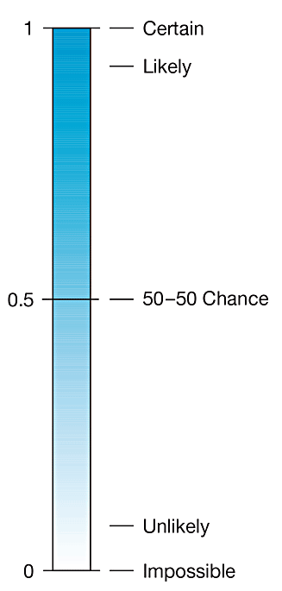
Three Common Approaches to Finding the Probability of an Event (2 of 6)
Possible values of probabilities and the more familiar and common expressions of likelihood

Slide 12

Three Common Approaches to Finding the Probability of an Event (3 of 6)
The following three approaches for finding probabilities result in values between 0 and 1: 0 $≤$ P(A) $≤$ 1.

Slide 13

Three Common Approaches to Finding the Probability of an Event (4 of 6)
​Relative Frequency Approximation of Probability Conduct (or observe) a procedure and count the number of times that event A occurs. P(A) is then approximated as follows:

Slide 14

Three Common Approaches to Finding the Probability of an Event (5 of 6)
​​Classical Approach to Probability (Requires Equally Likely Outcomes) If a procedure has n different simple events that are equally likely, and if event A can occur in s different ways, then
Caution When using the classical approach, always confirm that the outcomes are equally likely.

Slide 15
Three Common Approaches to Finding the Probability of an Event (6 of 6)
​​Subjective Probabilities P(A), the probability of event A, is estimated by using knowledge of the relevant circumstances.

Slide 16
Simulations
Simulations
Sometimes none of the preceding three approaches can be used. A simulation of a procedure is a process that behaves in the same ways as the procedure itself so that similar results are produced. Probabilities can sometimes be found by using a simulation.

Slide 17
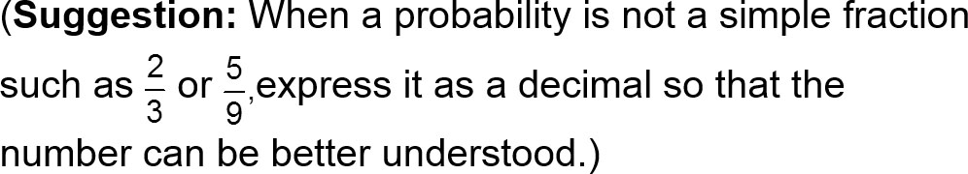
Rounding Probabilities
When expressing the value of a probability, either give the exact fraction or decimal or round off final decimal results to three significant digits.

Slide 18
Law of Large Numbers (1 of 2)
Law of Large Numbers
As a procedure is repeated again and again, the relative frequency probability of an event tends to approach the actual probability.

Slide 19
Law of Large Numbers (2 of 2)
Law of Large Numbers
CAUTIONS
The law of large numbers applies to behavior over a large number of trials, and it does not apply to any one individual outcome.
If we know nothing about the likelihood of different possible outcomes, we should not assume that they are equally likely. The actual probability depends on factors such as the amount of preparation and the difficulty of the test.

Slide 20
Example: Relative Frequency: Skydiving (1 of 3)
Find the probability of dying when making a skydiving jump.

Slide 21
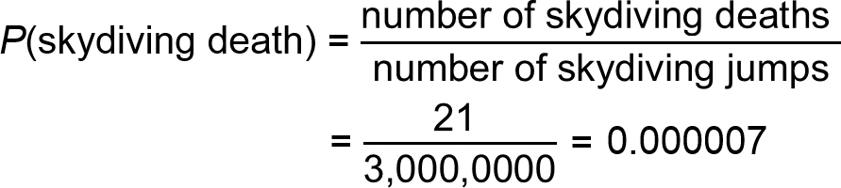
Example: Relative Frequency: Skydiving (2 of 3)
Solution
In a recent year, there were about 3,000,000 skydiving jumps and 21 of them resulted in deaths. We use the relative frequency approach as follows:

Slide 22
Example: Relative Frequency: Skydiving (3 of 3)
Solution
Here the classical approach cannot be used because the two outcomes (dying, surviving) are not equally likely.
A subjective probability can be estimated in the absence of historical data.

Slide 23
Example: Texting and Driving (1 of 4)
In a study of U.S. high school drivers, it was found that 3785 texted while driving during the previous 30 days, and 4720 did not text while driving during that same time period (based on data from “Texting While Driving . . . ,” by Olsen, Shults, Eaton, Pediatrics, Vol. 131, No. 6). Based on these results, if a high school driver is randomly selected, find the probability that he or she texted while driving during the previous 30 days.

Slide 24
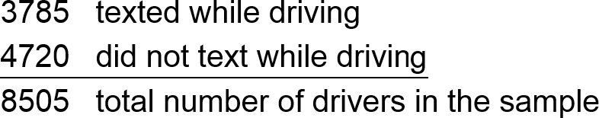
Example: Texting and Driving (2 of 4)
Solution
Instead of trying to determine an answer directly from the given statement, first summarize the information in a format that allows clear understanding, such as this format:

Slide 25
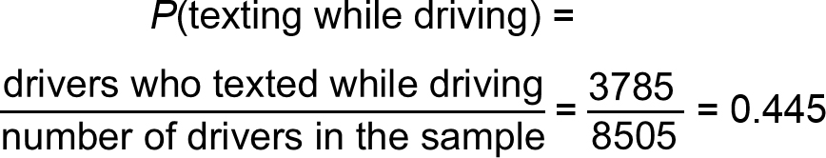
Example: Texting and Driving (3 of 4)
Solution
We can now use the relative frequency approach as follows:

Slide 26
Example: Texting and Driving (4 of 4)
Interpretation
There is a 0.445 probability that if a high school driver is randomly selected, he or she texted while driving during the previous 30 days.

Slide 27
Complementary Events
Complement

Slide 28
Example: Complement of Death from Skydiving (1 of 2)
In a recent year, there were 3,000,000 skydiving jumps and 21 of them resulted in death. Find the probability of not dying when making a skydiving jump.

Slide 29
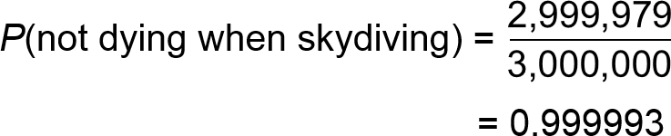
Example: Complement of Death from Skydiving (2 of 2)
Solution
Among 3,000,000 jumps there were 21 deaths, so it follows that the other 2,999,979 jumps were survived. We get
The probability of not dying when making a skydiving jump is 0.999993.

Slide 30
Identifying Significant Results with Probabilities (1 of 3)
The Rare Event Rule for Inferential Statistics
If, under a given assumption, the probability of a particular observed event is very small and the observed event occurs significantly less than or significantly greater than what we typically expect with that assumption, we conclude that the assumption is probably not correct.

Slide 31
Identifying Significant Results with Probabilities (2 of 3)
Using Probabilities to Determine When Results Are Significantly High or Significantly Low
Significantly high number of successes: x successes among n trials is a significantly high number of successes if the probability of x or more successes is unlikely with a probability of 0.05 or less. That is, x is a significantly high number of successes if P(x or more) ≤ 0.05*.
*The value 0.05 is not absolutely rigid.

Slide 32
Identifying Significant Results with Probabilities (3 of 3)
Using Probabilities to Determine When Results Are Significantly High or Significantly Low
Significantly low number of successes: x successes among n trials is a significantly low number of successes if the probability of x or fewer successes is unlikely with a probability of 0.05 or less. That is, x is a significantly low number of successes if P(x or fewer) ≤ 0.05*.
*The value 0.05 is not absolutely rigid.

Slide 33
Probability Review
The probability of an event is a fraction or decimal number between 0 and 1 inclusive.
The probability of an impossible event is 0.
The probability of an event that is certain to occur is 1.
Notation: P(A) = the probability of event A.

